Slide 1
Combustion of Zero Carbon Fuels MSc Engineering with Finance Mahima Gunewardena
Department of mechanical engineering

Slide 2

Overview
The Problem
Aims and Objectives
Current Research
Experimental Findings
Economics
Summary
Future works will be highlighted by the icon:

Slide 3
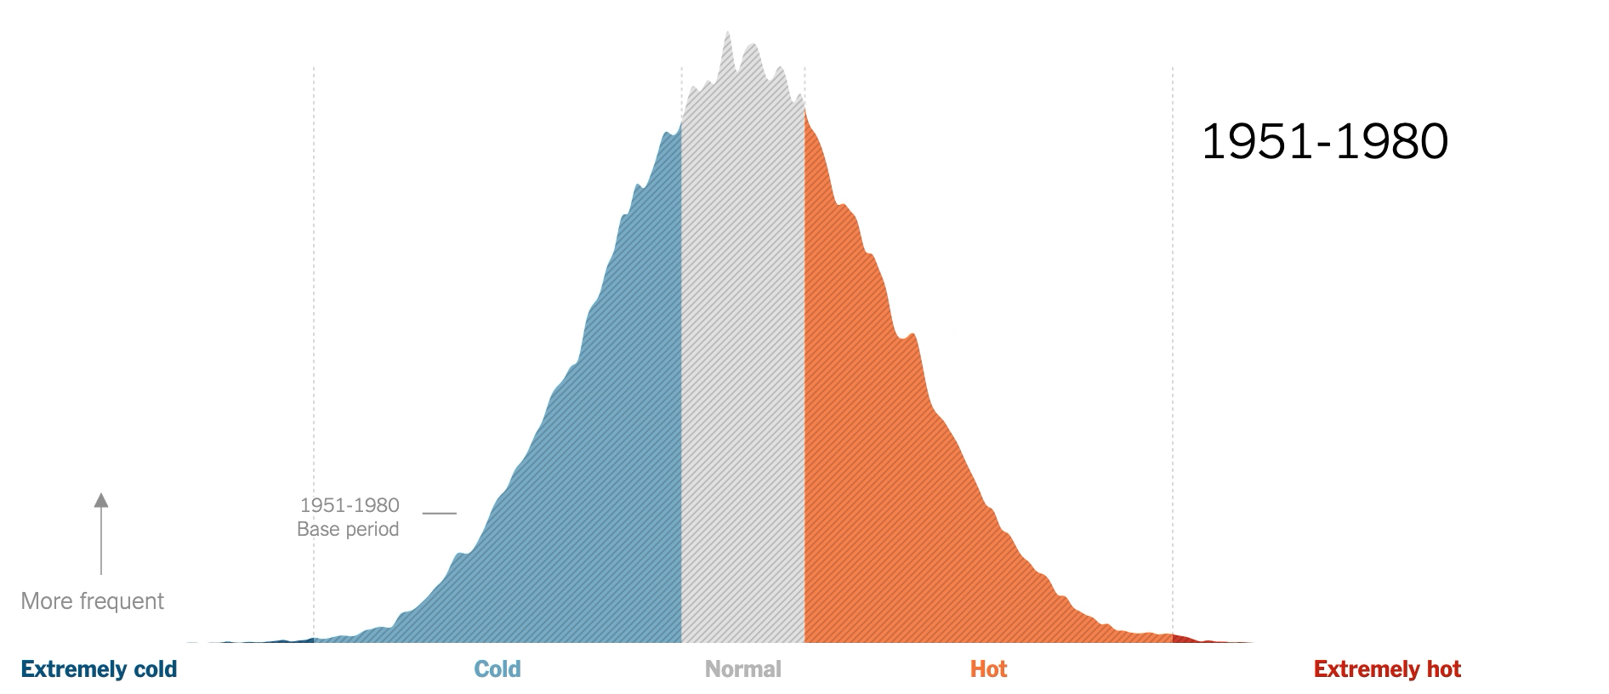
The Problem
Global temperatures are increasing due to increasing greenhouse gas emissions
[1] - “Teach About Climate Change With These 24 New York Times Graphs (Published 2019),” The New York Times, 2023. Accessed: Sep. 09, 2023. [Online]. Available: https://www.nytimes.com/2019/02/28/learning/teach-about-climate-change-with-these-24-new-york-times-graphs.html
‌

Slide 4
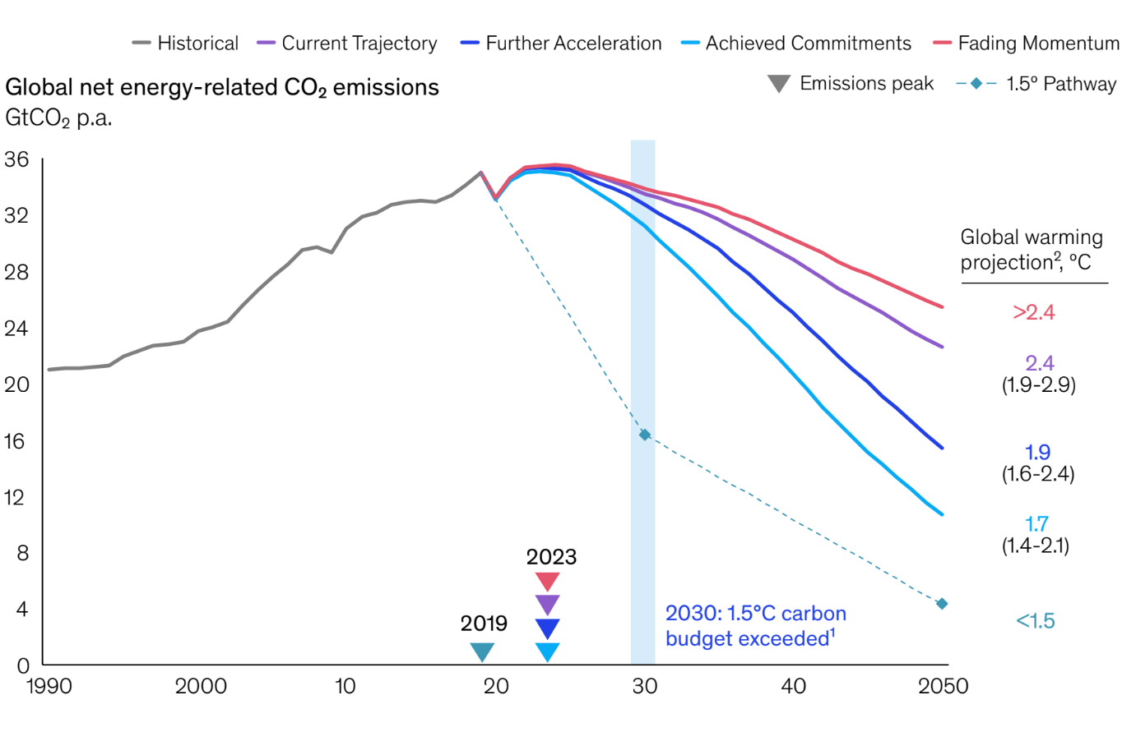
The Problem
Even the most stringent scenarios would not meet the targets required to prevent irreversible impacts on ecosystems, economies, and societies
[2] “Global Energy Perspective 2022,” McKinsey & Company, Apr. 26, 2022. https://www.mckinsey.com/industries/oil-and-gas/our-insights/global-energy-perspective-2022 (accessed Sep. 10, 2023).
‌

Slide 5
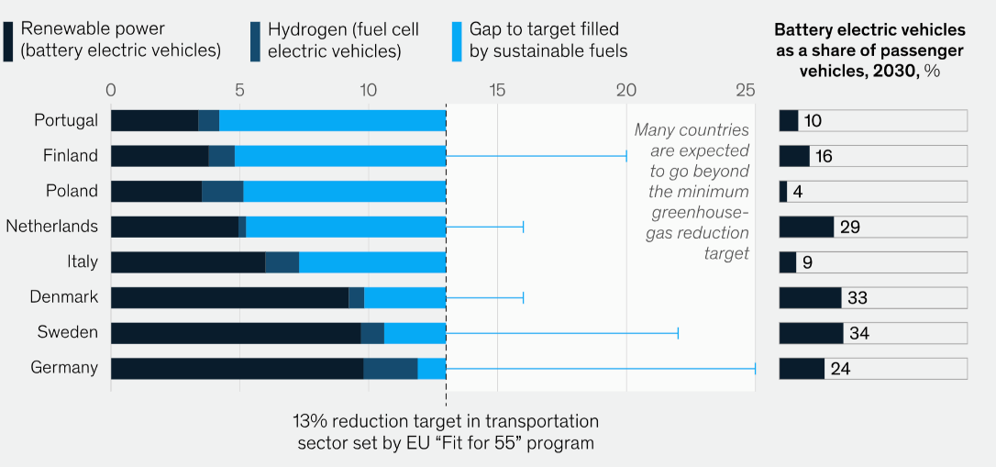
The Solution
Electric Vehicle’s Ideal Target
Mass Adoption Challenges
Alternative Fuels can be used which emit less carbon emissions to help bridge the decarbonization gap
[3] - N. Lash, Tapio Melgin, Agata Mucha-Geppert, and Ole Rolser, “Charting the global energy landscape to 2050: Sustainable fuels,” McKinsey & Company, Jul. 07, 2022. https://www.mckinsey.com/industries/oil-and-gas/our-insights/charting-the-global-energy-landscape-to-2050-sustainable-fuels (accessed Sep. 10, 2023).
‌

Slide 6
Aims and Objectives
Research Gap: Combustion Properties of Ammonia / Alcohol Blends
Fuel Formation
Determine optimal methods for fuel production
Chemical Analysis
Establish fuel blend composition
Combustion Characteristics
Assess combustion cycle's control, reliability, and efficiency
Economic Viability
Evaluate the financial feasibility of fuel production

Slide 7
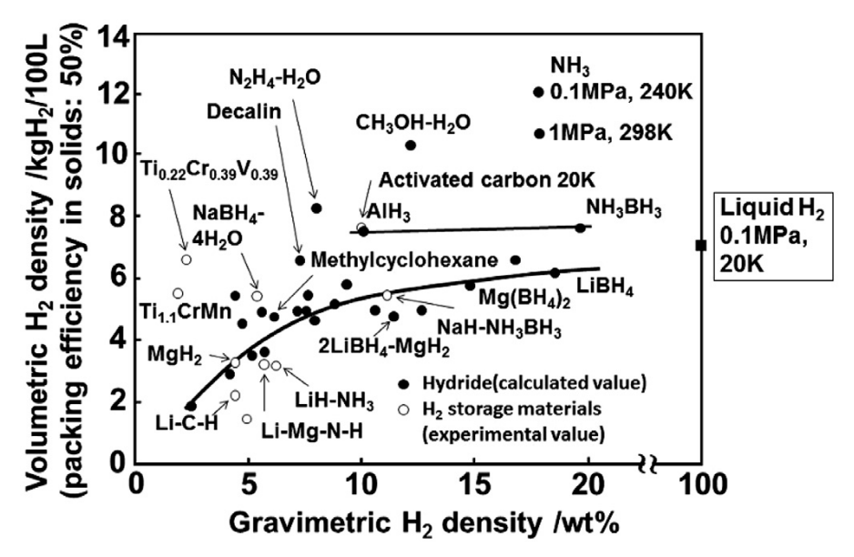
Ammonia
NH3 has a very high volumetric and energy density – great H2 carrier
Higher power output with less volume
Longer travel ranges possible
Storage and transportation cost reductions
[5] - A. Valera-Medina, H. Xiao, M Owen-Jones, and P. J. Bowen, “Ammonia for power,” ResearchGate, Nov. 2018. https://www.researchgate.net/publication/328665528_Ammonia_for_power (accessed Sep. 10, 2023).
‌

Slide 8
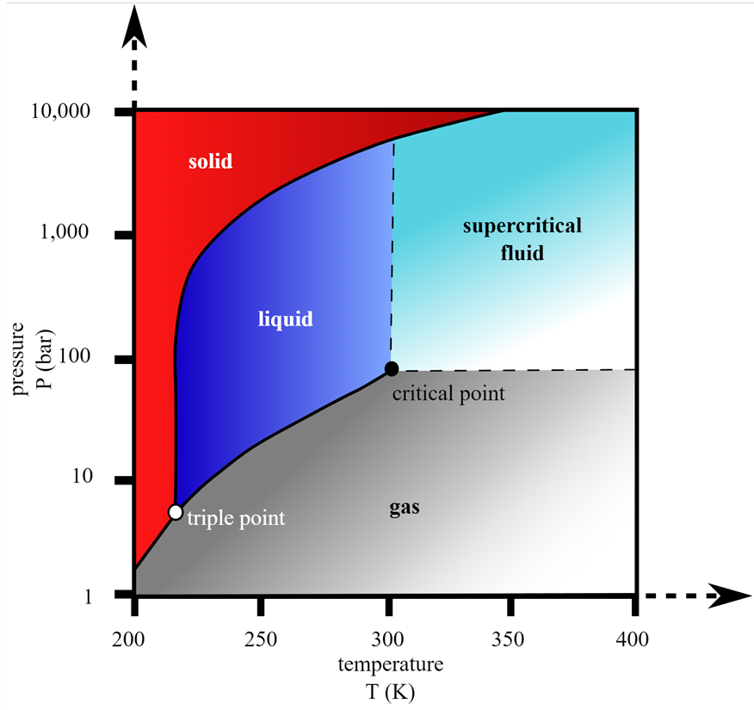

Ammonia
Combustion Problems:
Low flame speed
High auto-ignition temperature
High heat of vaporization
Narrow flammability limits (16-25 % by volume in air)
Dual Fuel Approach
[5] S. H. Crolius, “Switzerland – Page 2 – Ammonia Energy Association,” Ammoniaenergy.org, 2019. https://www.ammoniaenergy.org/regions/switzerland/page/2/ (accessed Sep. 10, 2023).
‌
Mix with a solvent which itself has great combustion characteristics

Slide 9
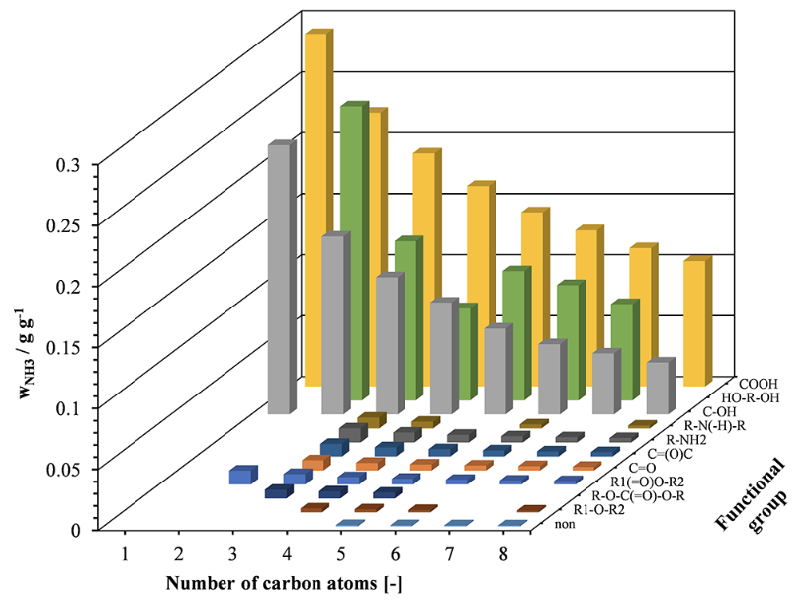
Current Research
The longer the carbon chain the lower the solubility
Carboxylic Acids – Highest Solubility
Excluded since they don’t exhibit good combustion properties
Mostly Alcohols and Di-alcohols are considered
Figure xxx - Conductor-like Screening Model for Real Solvents [4]
[4] - “Mixtures of Ammonia and Organic Solvents as Alternative Fuel for Internal Combustion Engines,” Energy & Fuels, 2019.https://pubs.acs.org/doi/full/10.1021/acs.energyfuels.9b01450?casa_token=2M9RNuwZOzMAAAAA:WDafUJS8a7dVivvubSOOTLHZQmtHPfalpo28g8KCNY2Bcpqdja9KcEfNyB6YodHQd0gdsK7eqWTNICQi (accessed Sep. 10, 2023).
‌

Slide 10
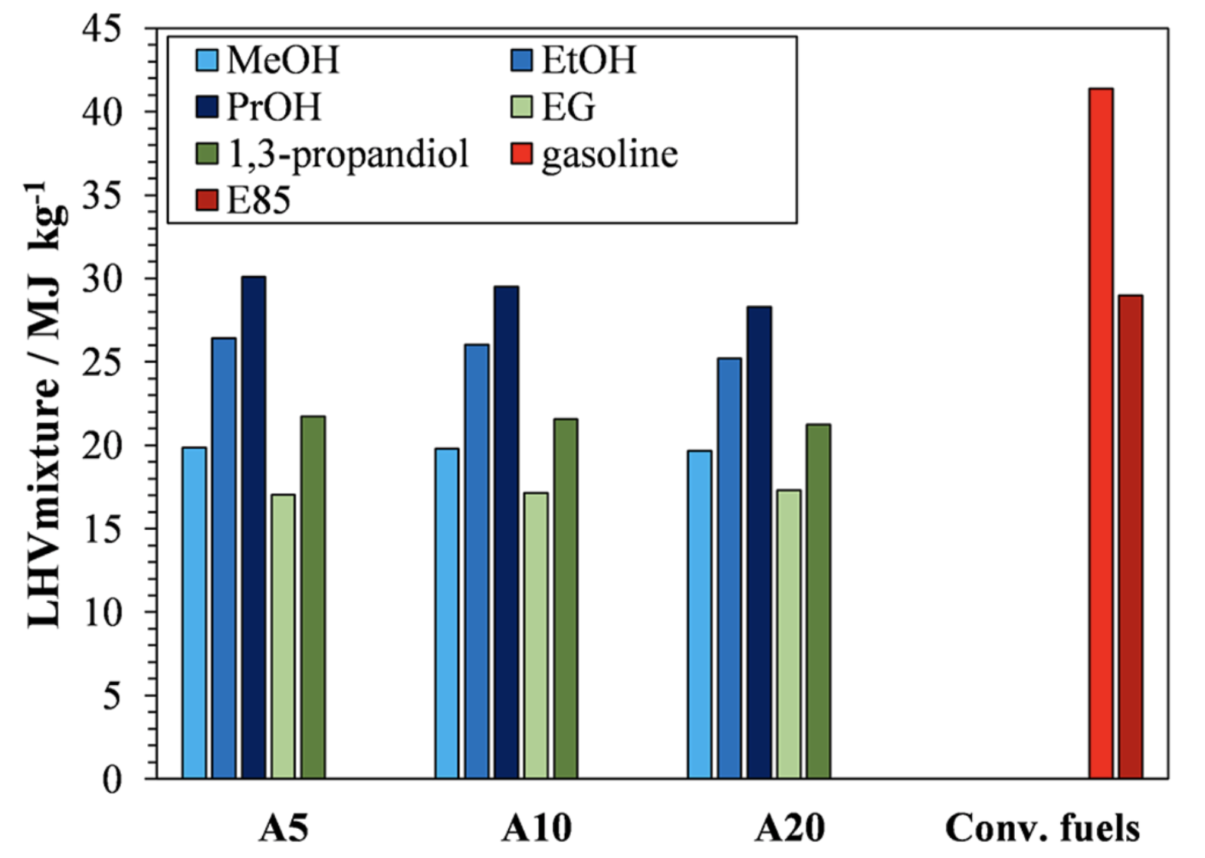
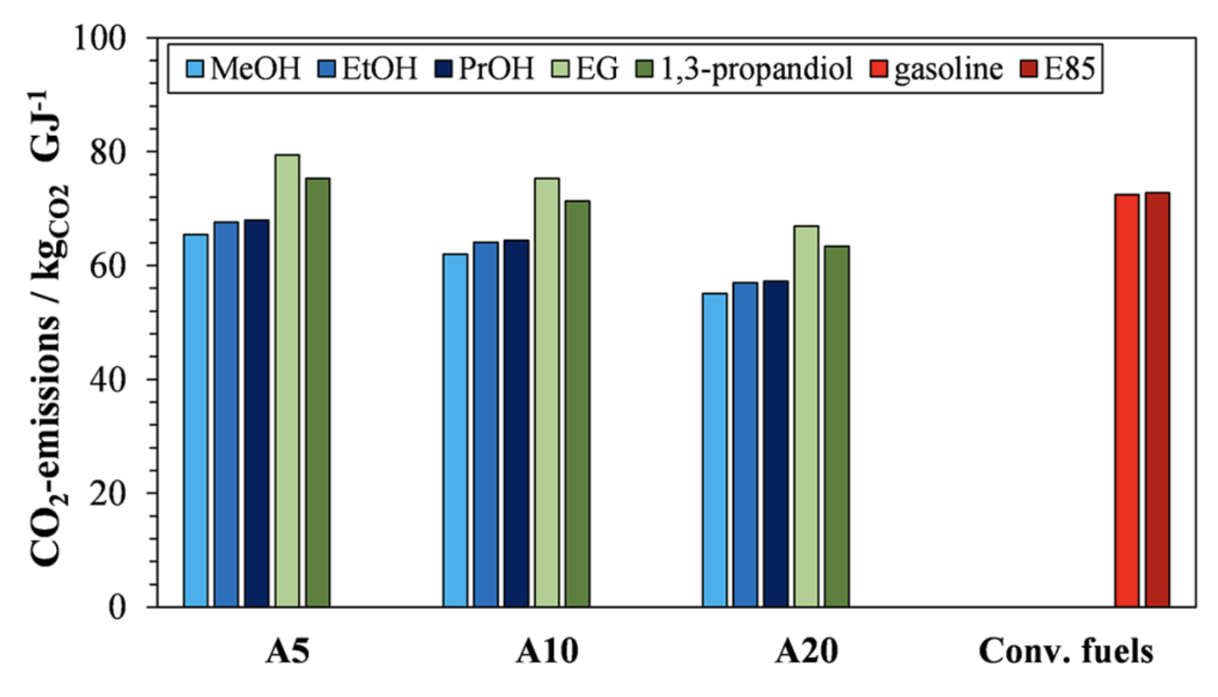
Current Research
*A5 = 5 wt% NH3
LHV (Lower Heating Value) of NH3 / Solvent Mixtures
Up to 70% - 50% compared to Gasoline
Lower CO2 emissions as NH3 content increases
[4] - “Mixtures of Ammonia and Organic Solvents as Alternative Fuel for Internal Combustion Engines,” Energy & Fuels, 2019.https://pubs.acs.org/doi/full/10.1021/acs.energyfuels.9b01450?casa_token=2M9RNuwZOzMAAAAA:WDafUJS8a7dVivvubSOOTLHZQmtHPfalpo28g8KCNY2Bcpqdja9KcEfNyB6YodHQd0gdsK7eqWTNICQi (accessed Sep. 10, 2023).
‌

Slide 11
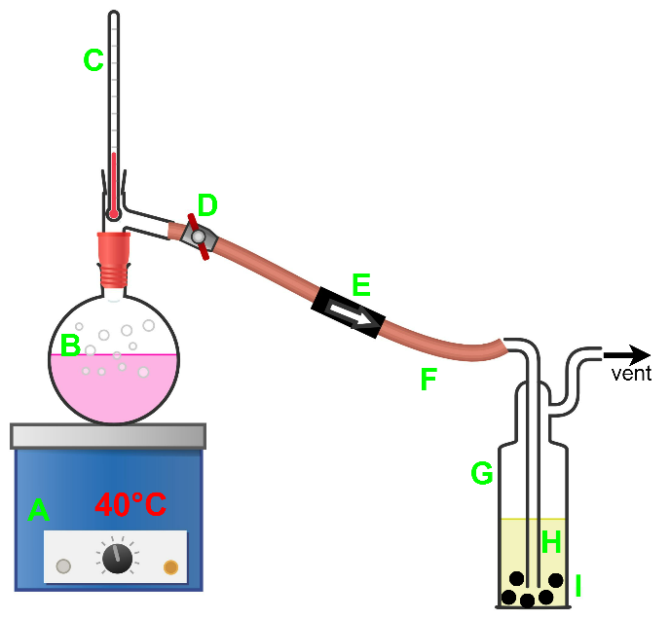
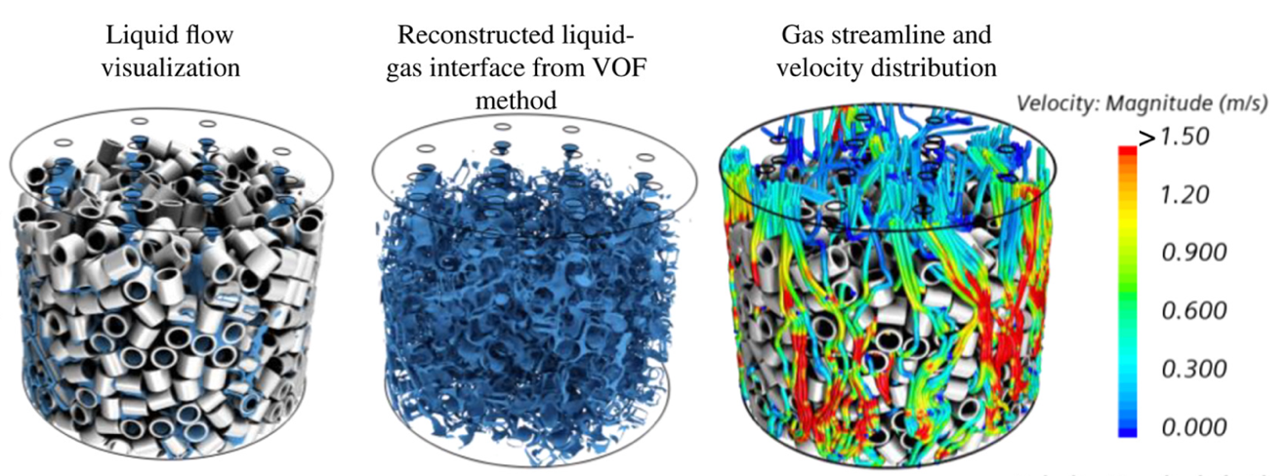
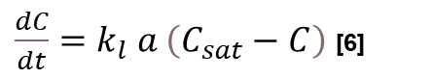
Experimental Findings
Rate of mass transfer
Mass transfer coefficient
Concentration Gradient
Fuel Mixture Preparation
$\frac{dC}{dt}=k_{l} a \left(C_{sat}−C\right)$ [6]
ID | Item
A | Heating mantle
B | Heating flask with aqueous ammonia
C | Thermometer
D | Stopcock
E | One way valve
F | Rubber tubing
G | Gas washing bottle with sparger and rasching rings
H | Ethanol
I | Column packing
Interfacial Area
Raschig Rings + Sparger
Increase area = Increase rate

Slide 12
Experimental Findings
Chemical Analysis - Calorimetry
Ethanol J/g | Ethanol + NH3 / J/g | Methanol J/g | Methanol + NH3 J/g
25,838 | 27,528 | 15,504 | 16,868
24,373 | 24,929 | 17,508 | 19,344
23,380 | 24,060 | 16,459 | 18,891
24,228 | 24,422 | 18,232 | 18,303
24,218 | 25,207 | 17,759 | 17,589
24,865 | 24,384 | 16,261 | 18,653
The difference between calorific values was used to identify presence of NH3
Ethanol Mixture – 3 wt% NH3 of mixture
Methanol Mixture – 6 wt% NH3 of mixture

Slide 13
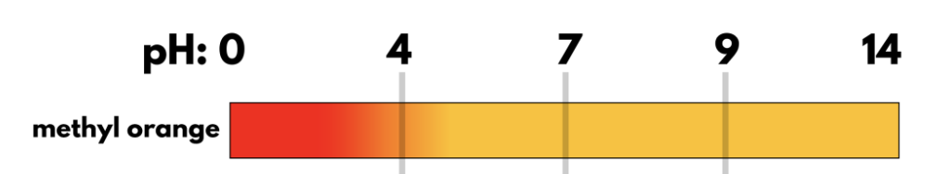
Experimental Findings
Chemical Analysis - Acid Base Titrations
Figure xxx – Ethanol Titration Curve
Figure xxx – Ethanol Titration Curve Equivalence Point
Figure xxx – Methyl Orange colour indication range [6]
[6] A. Cher, “O Level titration TYS questions | Chem Not Cheem,” Chem Not Cheem, Jun. 06, 2020. https://chemnotcheem.com/o-level-acid-base-titration-questions/ (accessed Sep. 11, 2023).
‌

Slide 14

Experimental Findings
Sample | Average Titre / ml | NH3 wt %
Ethanol | 41 | 3.8
Methanol | 62 | 6.3
~ 13 wt%
The NH3 wt% for both solvents are consistent for both methods
Lower than expected, didn’t reach the solubility limit
~ 8 wt%
Measure how long it takes for equilibrium to reach via pH measurements
Investigate how additives could improve the solubility of NH3
Alkali metal salts have been shown to suppress ammonia vaporization [8]
Figure xxx – NH3 solubility in solvents [7]
[7] - “Table V Solubility of Ammonia in Alcohols*.” Available: https://airgasspecialtyproducts.com/wp-content/uploads/2016/02/Solubility_of_Ammonia_in_Alcohols_.pdf
‌
[8] S. Salentinig, P. Jackson, and M. I. Attalla, “A computational study of the suppression of ammonia volatility in aqueous systems using ionic additives,” Structural Chemistry, vol. 25, no. 1, pp. 159–168, Apr. 2013, doi: https://doi.org/10.1007/s11224-013-0263-8.
‌

Slide 15
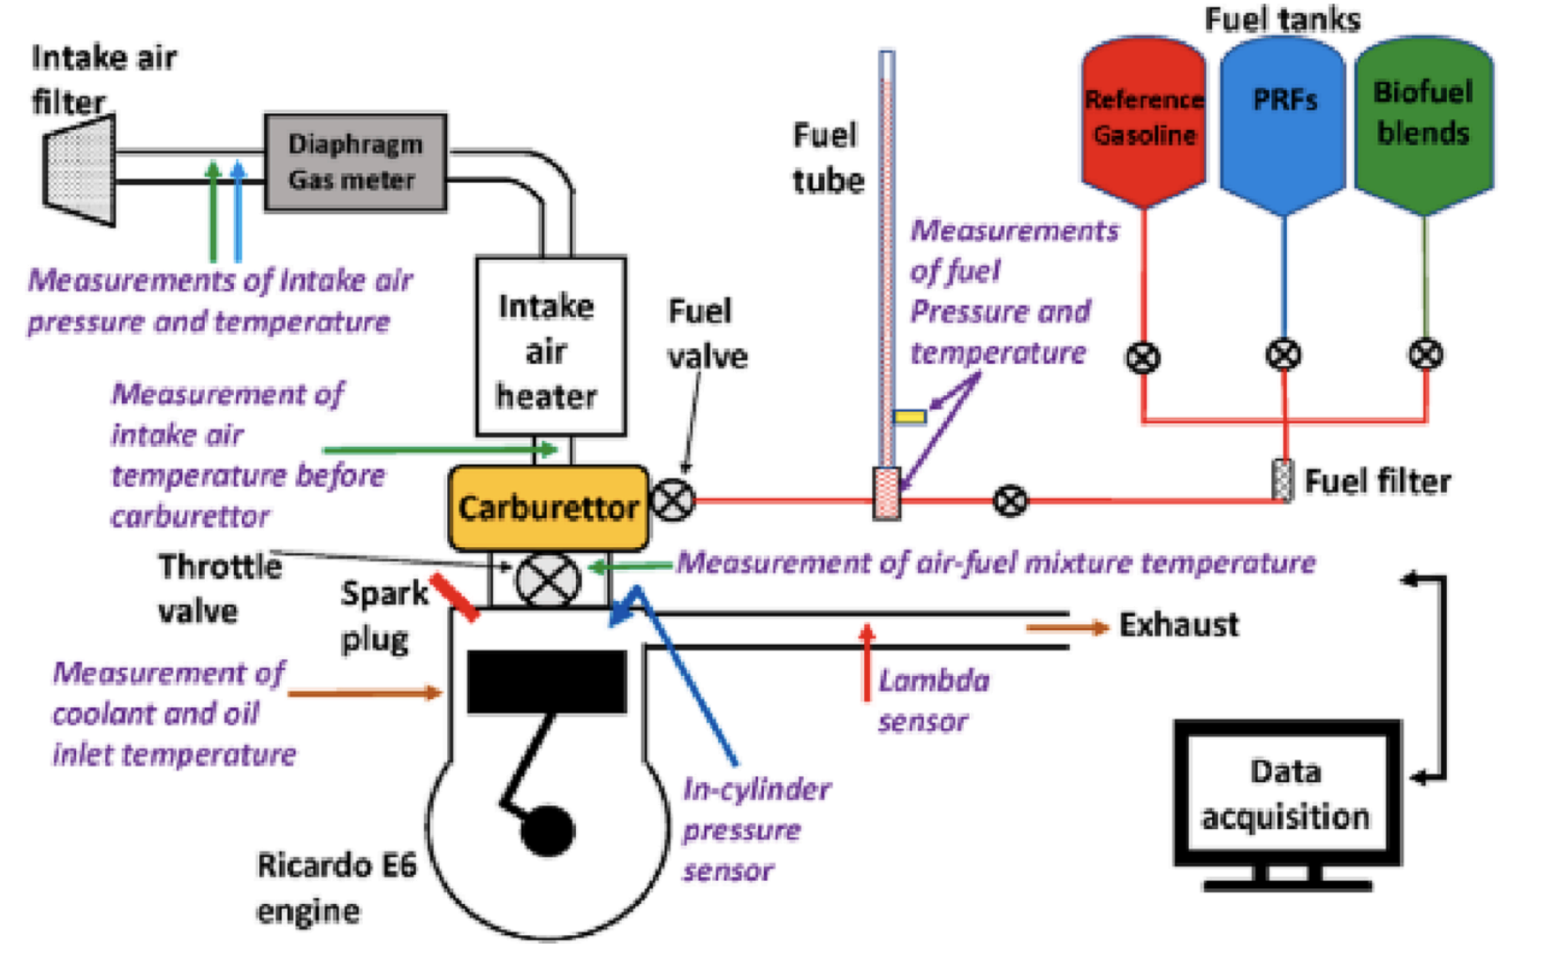
Experimental Findings
Engine Testing
PETROL
PURE
BLEND
Ricardo E6 Engine - spark ignition, 600 rpm, naturally aspirated, λ = 1, Compression Ratio = 4.5, Spark Timing = 13 (BTDC), wide open throttle
All parameters were kept constant for samples with the same solvents.

Slide 16
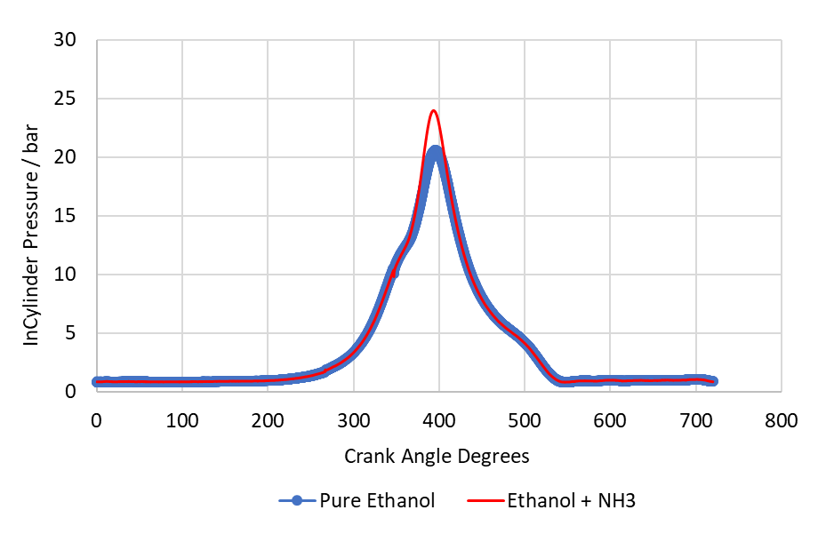
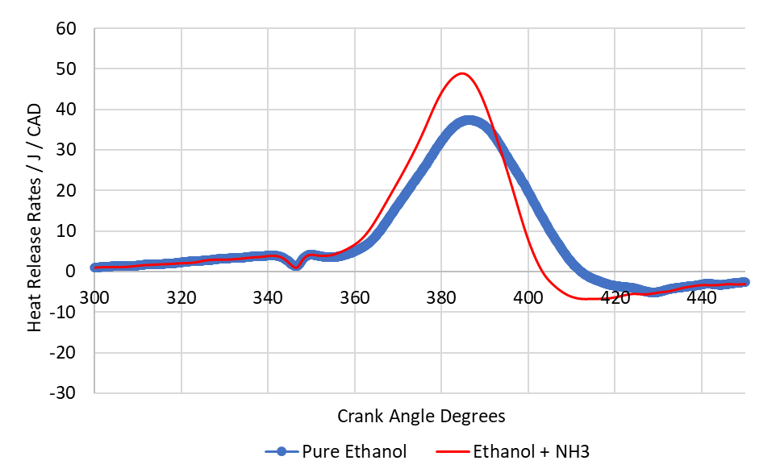
Experimental Findings
Engine Testing
Combustion Characteristic | Pure Ethanol | Ethanol + NH3
Average NIMEP | 7.356 | 7.813
Average GIMEP | 7.469 | 7.916
COV NIMEP | 0.083 | 0.039
COV GIMEP | 0.08 | 0.036
NH3 has provided more power and improved engine efficiency
NH3 has also provided more stable combustion

Slide 17
Experimental Findings
Engine Testing
Possible fuel stratification
Molecular Dynamic Simulations and Spectroscopic Techniques (LIF)

Slide 18
Experimental Findings
Fuel degradation observed for all samples
A larger visual change in the Methanol / NH3 sample compared to Ethanol / NH3
Degraded samples were not tested, performance losses expected
Isotrope tracing to determine chemical mechanism of degradation under various conditions with GCMS analysis
1 month
1 month

Slide 19
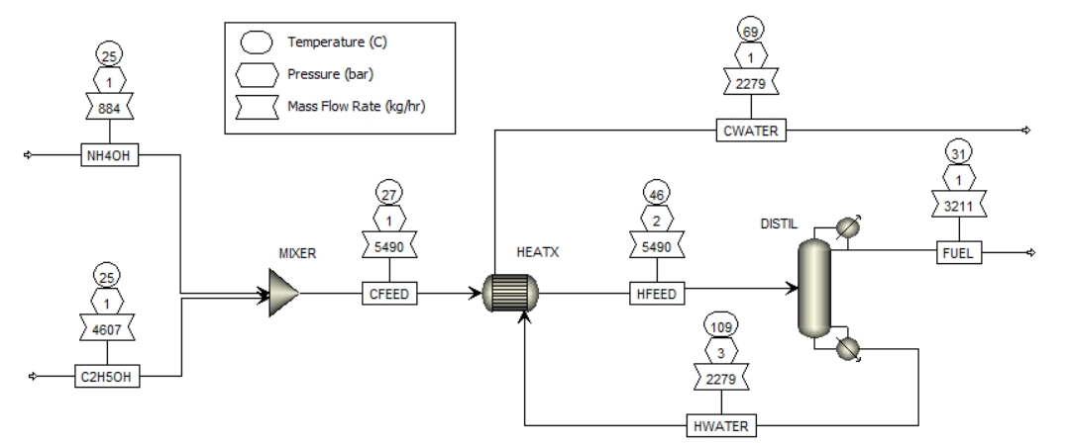
Economics
Figure xxx – Aspen Simulation Flowsheet
Figure xxx – Manufacturing cost drivers
Operating costs are the majority of the costing but are predictable and fairly consistent
Raw Materials costs are highly volatile
Fuel | £ / L
Ethanol / NH3 | 5.79
Petrol | 1.43
Diesel | 1.69

Slide 20
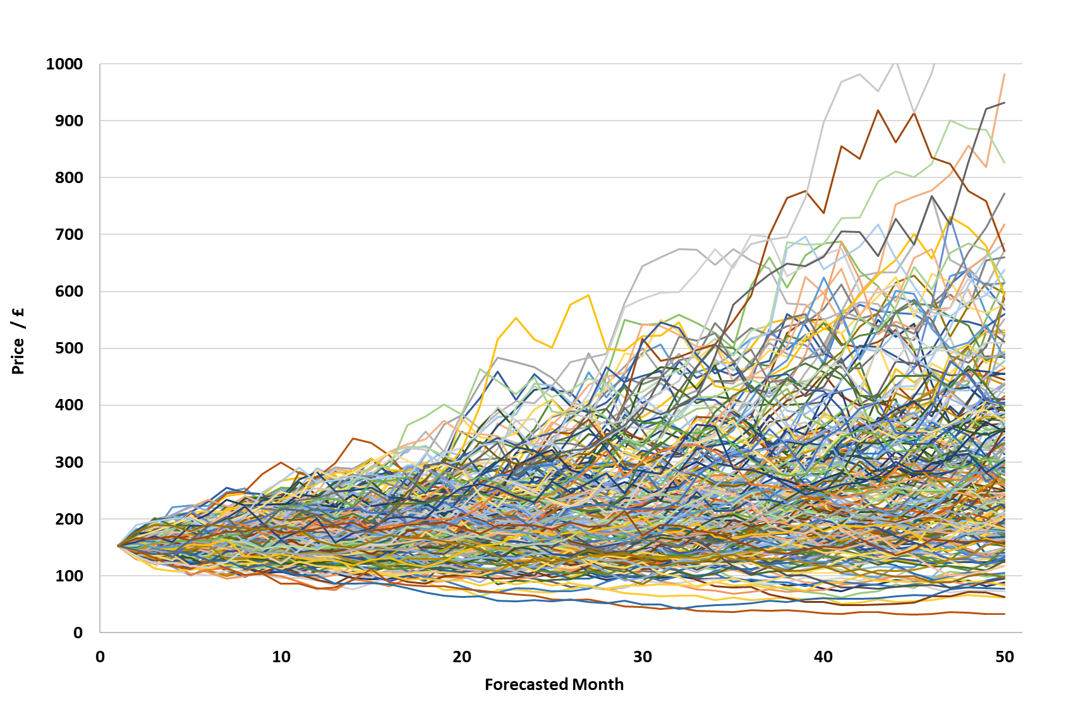
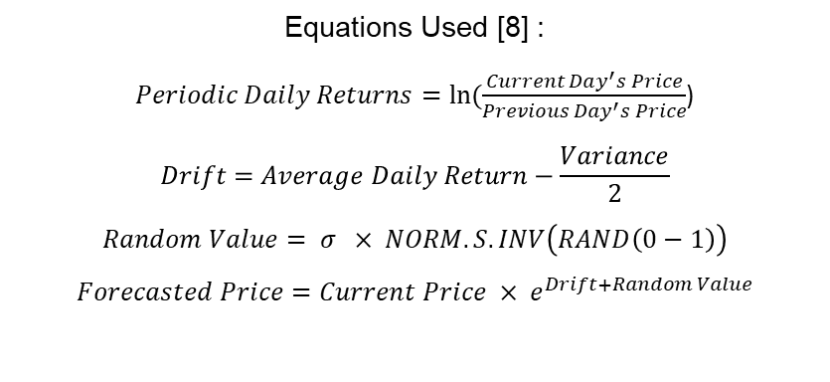
Economics
Monte Carlo Simulation
Equations Used [8] :
$Periodic Daily Returns=\ln{(\frac{Current Day^{′}s Price}{Previous Day^{′}s Price}}$)
$$Drift=Average Daily Return−\frac{Variance}{2}$$
$$Random Value= σ × NORM.S.INV\left(RAND\left(0−1\right)\right)$$
$$Forecasted Price=Current Price × e^{Drift+Random Value}$$
Assumptions:
Future returns are normally distributed
Efficient Market Hypothesis
Constant Drift
Constant Variance
Figure xxx – Monte Carlo
[8] “Monte Carlo Simulation: History, How it Works, and 4 Key Steps,” Investopedia, 2023. https://www.investopedia.com/terms/m/montecarlosimulation.asp (accessed Sep. 11, 2023).
‌

Slide 21
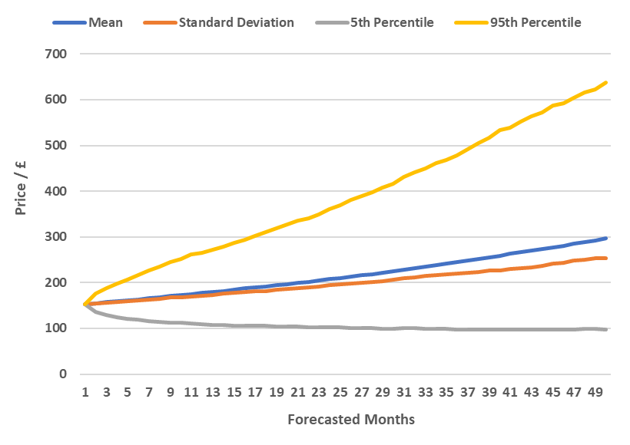
Economics
Monte Carlo Simulation
Jump diffusion models could be implemented which allows for better capture of market events
Back testing of Monte Carlo simulations to determine which distributions are appropriate
Figure xxx – Statistical Analysis of Monte Carlo Simulation
[x]“Merton Jump Diffusion Model with Python,” Codearmo.com, 2021. https://www.codearmo.com/python-tutorial/merton-jump-diffusion-model-python (accessed Sep. 12, 2023).
‌

Slide 22
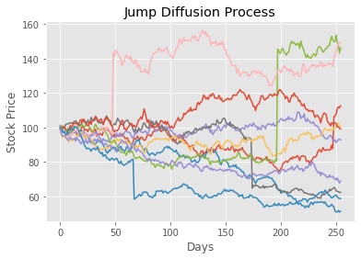
Economics
Monte Carlo Simulation
Jump diffusion models could be implemented which allows for better capture of market events
Back testing of Monte Carlo simulations to determine which distributions are appropriate
Figure xxx – Jump Diffusion Model [x]
[x]“Merton Jump Diffusion Model with Python,” Codearmo.com, 2021. https://www.codearmo.com/python-tutorial/merton-jump-diffusion-model-python (accessed Sep. 12, 2023).
‌

Slide 23
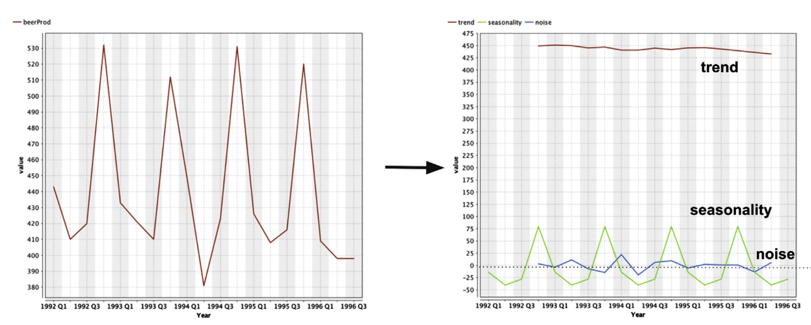
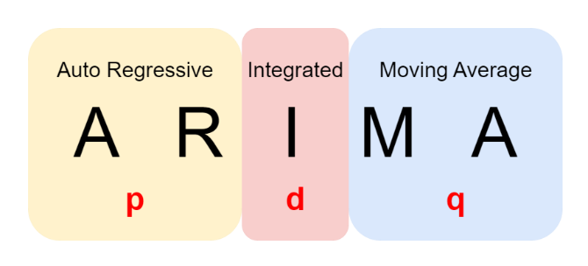
Economics
Breaks time series data into patterns and replicates them in the future
4 main patterns: Seasonality, General Trend, Cyclicality and Noise
Figure xxx – Fundamentals of ARIMA

Slide 24
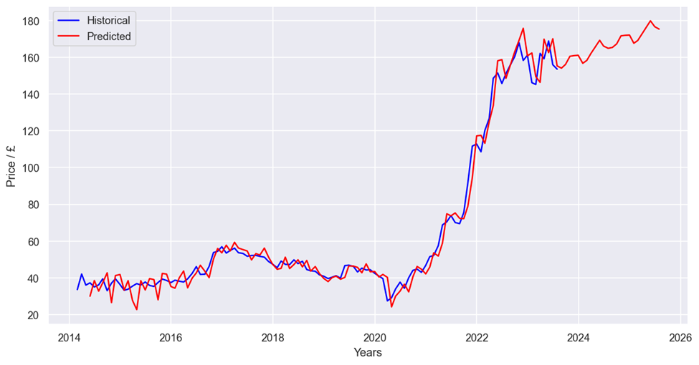
Economics
Time Series Data : Goldman Sachs Chicago Ethanol Index
The model closely follows historical data and thus can be considered robust
A relative price increase is forecasted for the next 5 years.
Increased demand in the future expected
Investment Opportunity
Figure xxx – Ethanol 5-year prediction

Slide 25


Conclusion
Technical
Economical
Ammonia-based fuel samples exhibited more power and better combustion stability
A decrease in power in all ammonia-based samples, could indicate fuel stratification
Fuel blends did not reach their solubility limits, difficulty suppressing vaporization
As of today, cost of fuel would make it unattractive
Demand increase indicated by Monte Carlo and ARIMA models.
To make the fuel competitive, tax levies, incentives and policy changes would be required

